Slide 1
Effect of Various Parameters in Flash Cut Foreground Extraction with
Flash/Non-Flash Pairs
By Lingxi Zhang

Slide 2
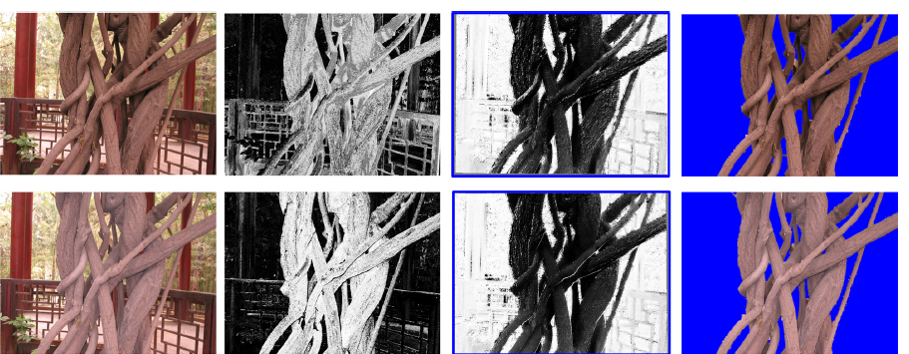
Where the Story began

Slide 3
What do we need?
Motion?
Stereo?
Infrared light?

Slide 4
What do we need?
No! Only two images are needed!
One Flash, the other not!

Slide 5
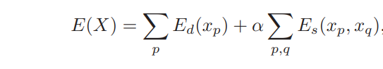
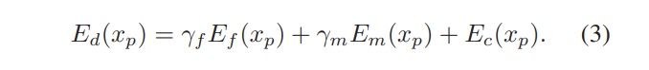
How Possible?
Output: just a binary matrix of 0(background) and 1(foreground), let us call it x_p
Minimizing the energy of an Markov random Field

Slide 6
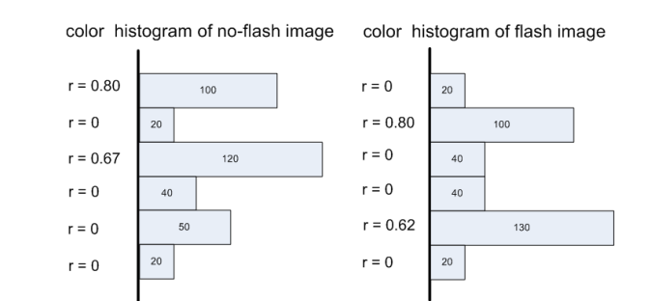
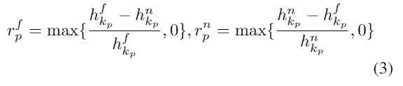
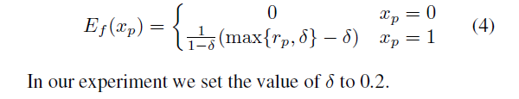
The foreground term
Intensity Histogram
Flash ratio
The final foreground term

Slide 7
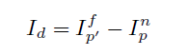
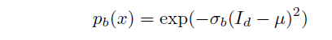
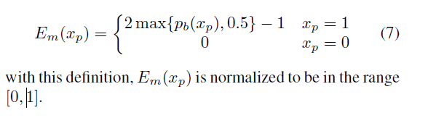
The background term
Image Difference
Background probability
The final background term

Slide 8
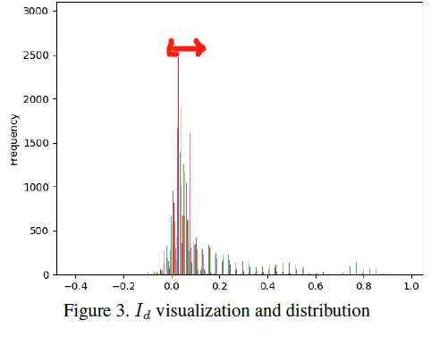
Mu,sigma, motion Estimation

Slide 9
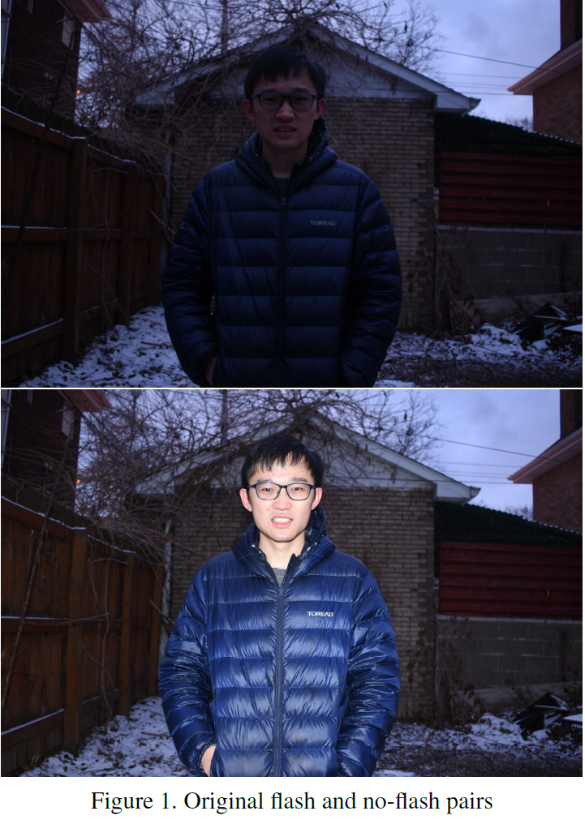
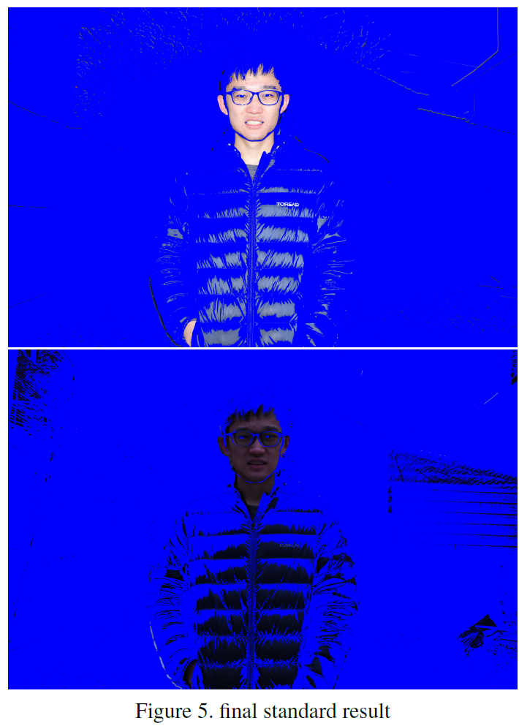
Original Pictures vs. Final Result

Slide 10
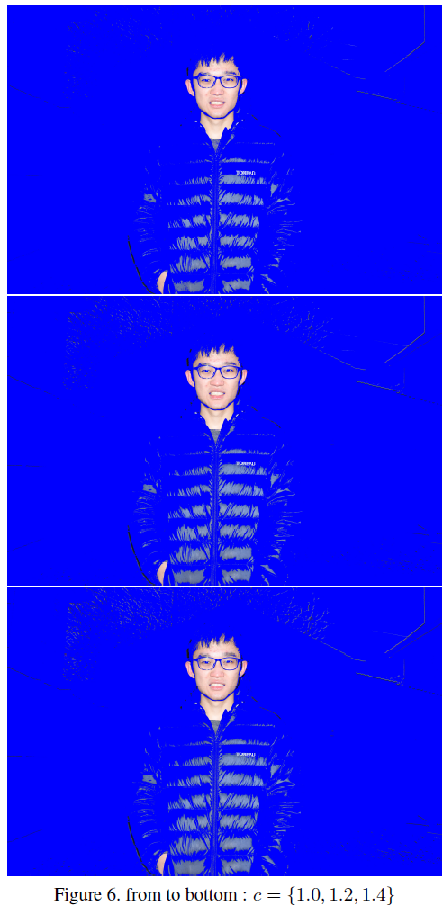
Changing Contrast Parameter

Slide 11
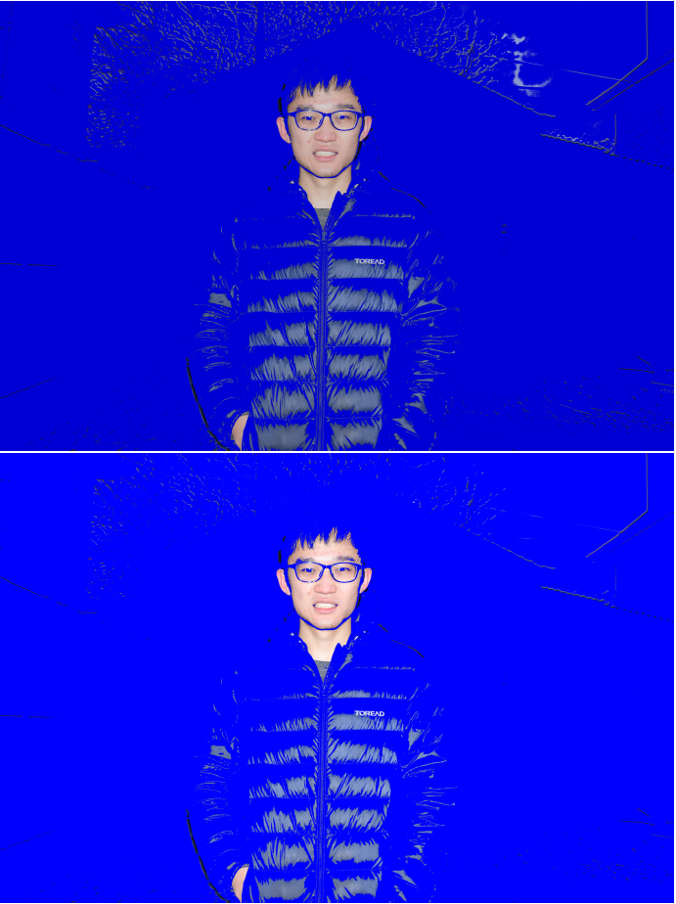
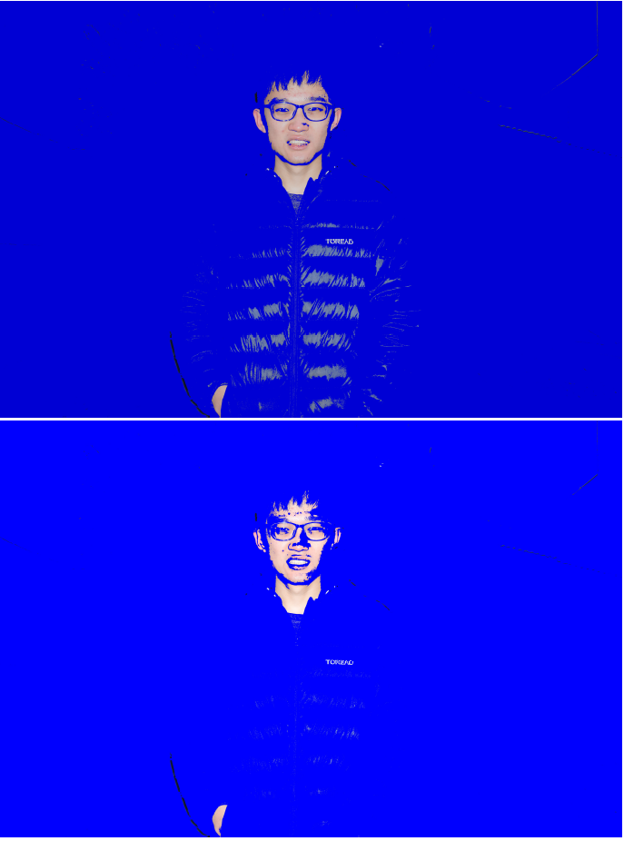
Changing Sigma Parameter

Slide 12
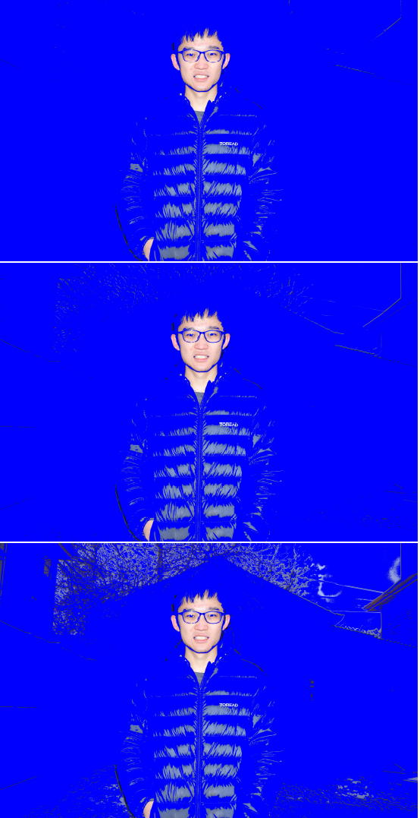
Changing f/b weight Parameter

Slide 13
Conclusion
Among all parameters, the difference standard deviation sigma is
the most important factor in our analysis. As a side result, sigma is probably
the most ideal candidate for implement continuous distinction in
the future(like we decide how
much we want in the foreground instead of binary distinction)

Slide 14
Conclusion
The effect of
a lot of the factors are probably underestimated. For instance, the dark night and
low ISO setting, as well as many implementation changes from the original paper that
may cause drastic change. All in all, we are looking forward to examining the effect these
factors and making improvements accordingly.

Slide 15
Thank you for your patience!

